Slide 1
Problems on Ohm’s law, KCL & KVL
Module 1: Fundamentals of DC Circuits
EEE1024 Fundamentals of Electrical and Electronics Engineering

Slide 2
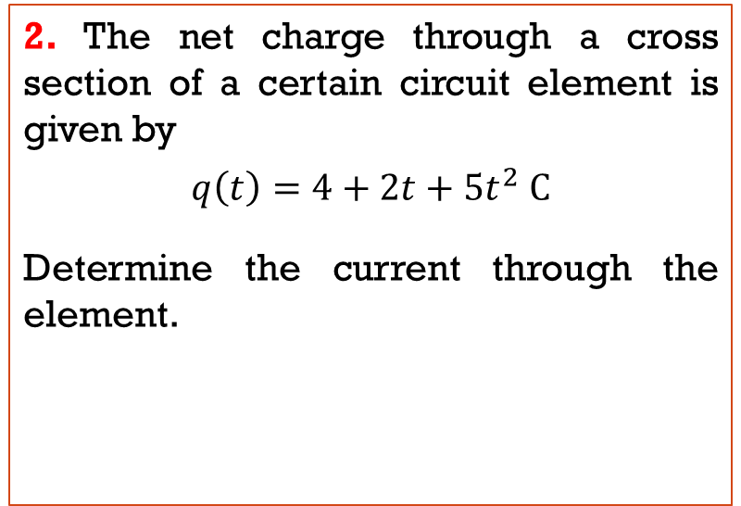
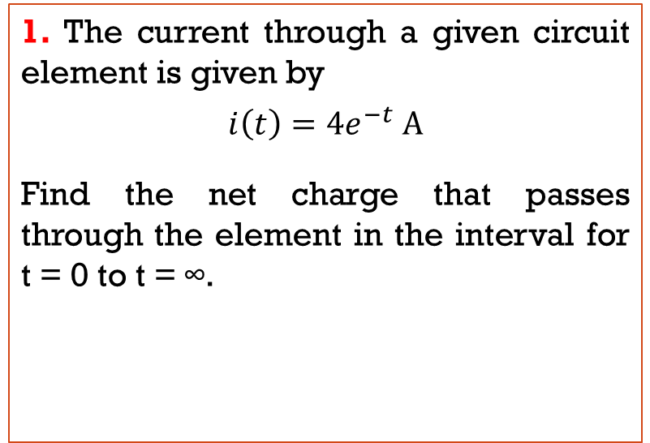
Current & charge
Current is the time rate of flow of electrical charge. Its units are amperes (A), which are equivalent to coulombs per second (C/s)
1. The current through a given circuit element is given by
$$i\left(t\right)=4e^{−t} A$$
Find the net charge that passes through the element in the interval for t = 0 to t = ∞.
2. The net charge through a cross section of a certain circuit element is given by
$$q\left(t\right)=4+2t+5t^{2} C$$
Determine the current through the element.

Slide 3
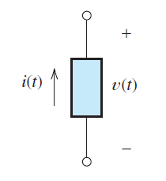
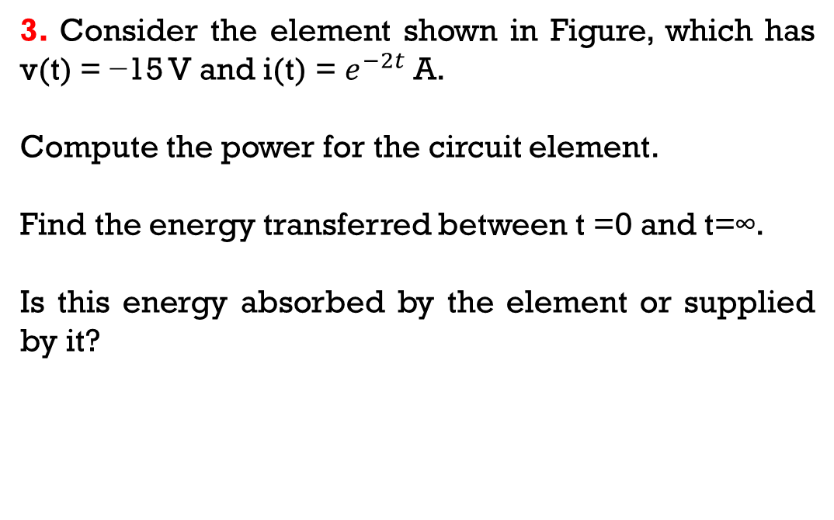
Power & energy
3. Consider the element shown in Figure, which has v(t) = −15 V and i(t) = $e^{−2t}$ A.
Compute the power for the circuit element.
Find the energy transferred between t =0 and t=∞.
Is this energy absorbed by the element or supplied by it?

Slide 4
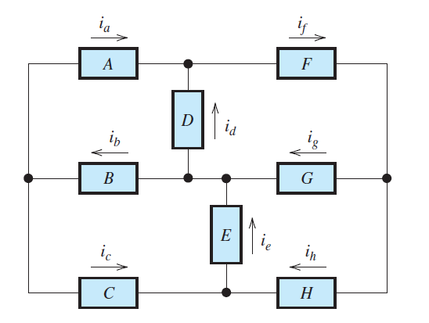
KCL
4. Given that ib = 3 A; ic = 5 A; ig = 6 A, and ie = 5 A, determine the values of other currents
5. Determine the values of the other currents in Figure, given that ia = 2A, ic = −3A, ig = 6A, and ih = 1A.

Slide 5
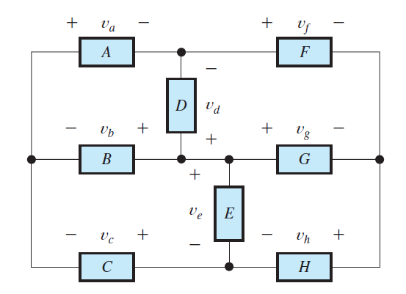
KVL
6. We know that va = 10 V, vb = −3 V, vf = 12 V, and vh = 5 V, solve for the other voltages

Slide 6
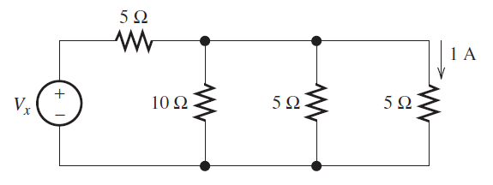
Ohm’s law, kcl & kvl
7. Consider the circuit shown in Figure, Use repeated applications of Ohm’s law, KVL, and KCL to eventually find Vx.

Slide 7
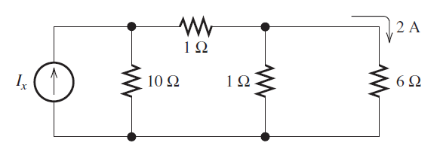
Ohm’s law, kcl & kvl
8. Use repeated applications of Ohm’s law, KVL, and KCL to eventually find the value of Ix in the circuit

